Slide 1
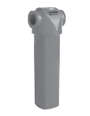
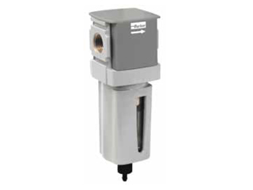
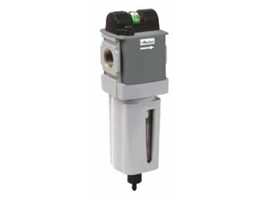
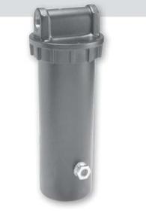
Using Shop Air in Application of CO2 Cleaning
Filters used for the filtration of the shop air:
Bulk Liquid Remover: Parker P3TFA94WCAN
85 SCFM
232 PSIG
Particulate Filtration: Parker P32FB94ESAN
82 SCFM
5 um filter
Coalescing Filtration: Parker P32FB92DGAN
.01 um filter
Descant Dryer: Parker DRP-14-447/003
DD15-04 housing
15 SCFM

